Slide 1
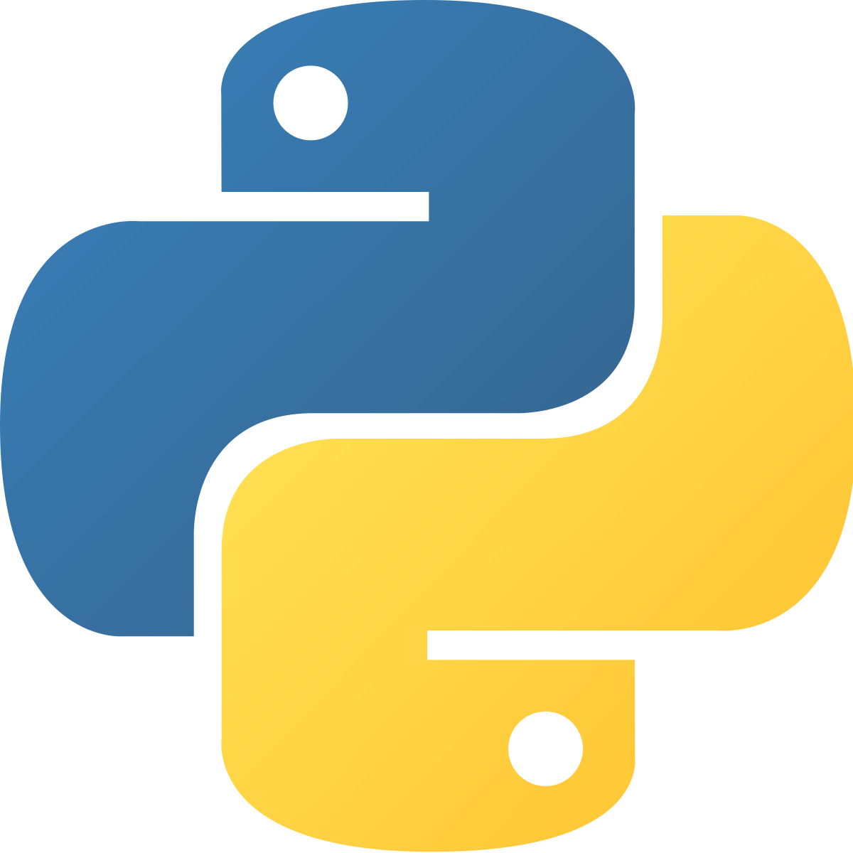
Python Objected Oriented Programming (OOP) Part II
Coding Club 3/29/2021

Slide 2
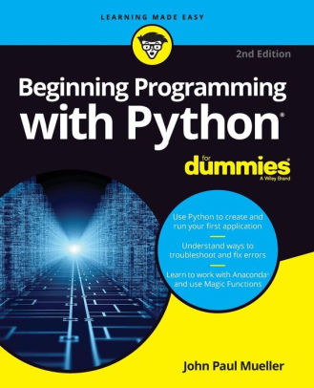
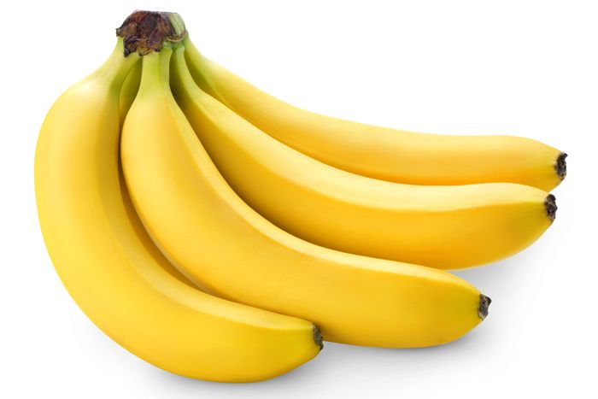
Functional Programming vs OOP
Functional Programming
Function output depends only on input
Involves variables and functions
Data is stored in variables
Ex. Some Python Built in Functions:
abs()
pow()
sum()
Every other function we have created so far…
Object Oriented Programming
Python is an object-oriented programming language. Others include Java, C++, C#, JavaScript, Swift
Involves classes, methods, and objects
Data is stored in objects—an object’s attributes
Ex. List methods:
list.append()
list.remove()
list.index()

Slide 3
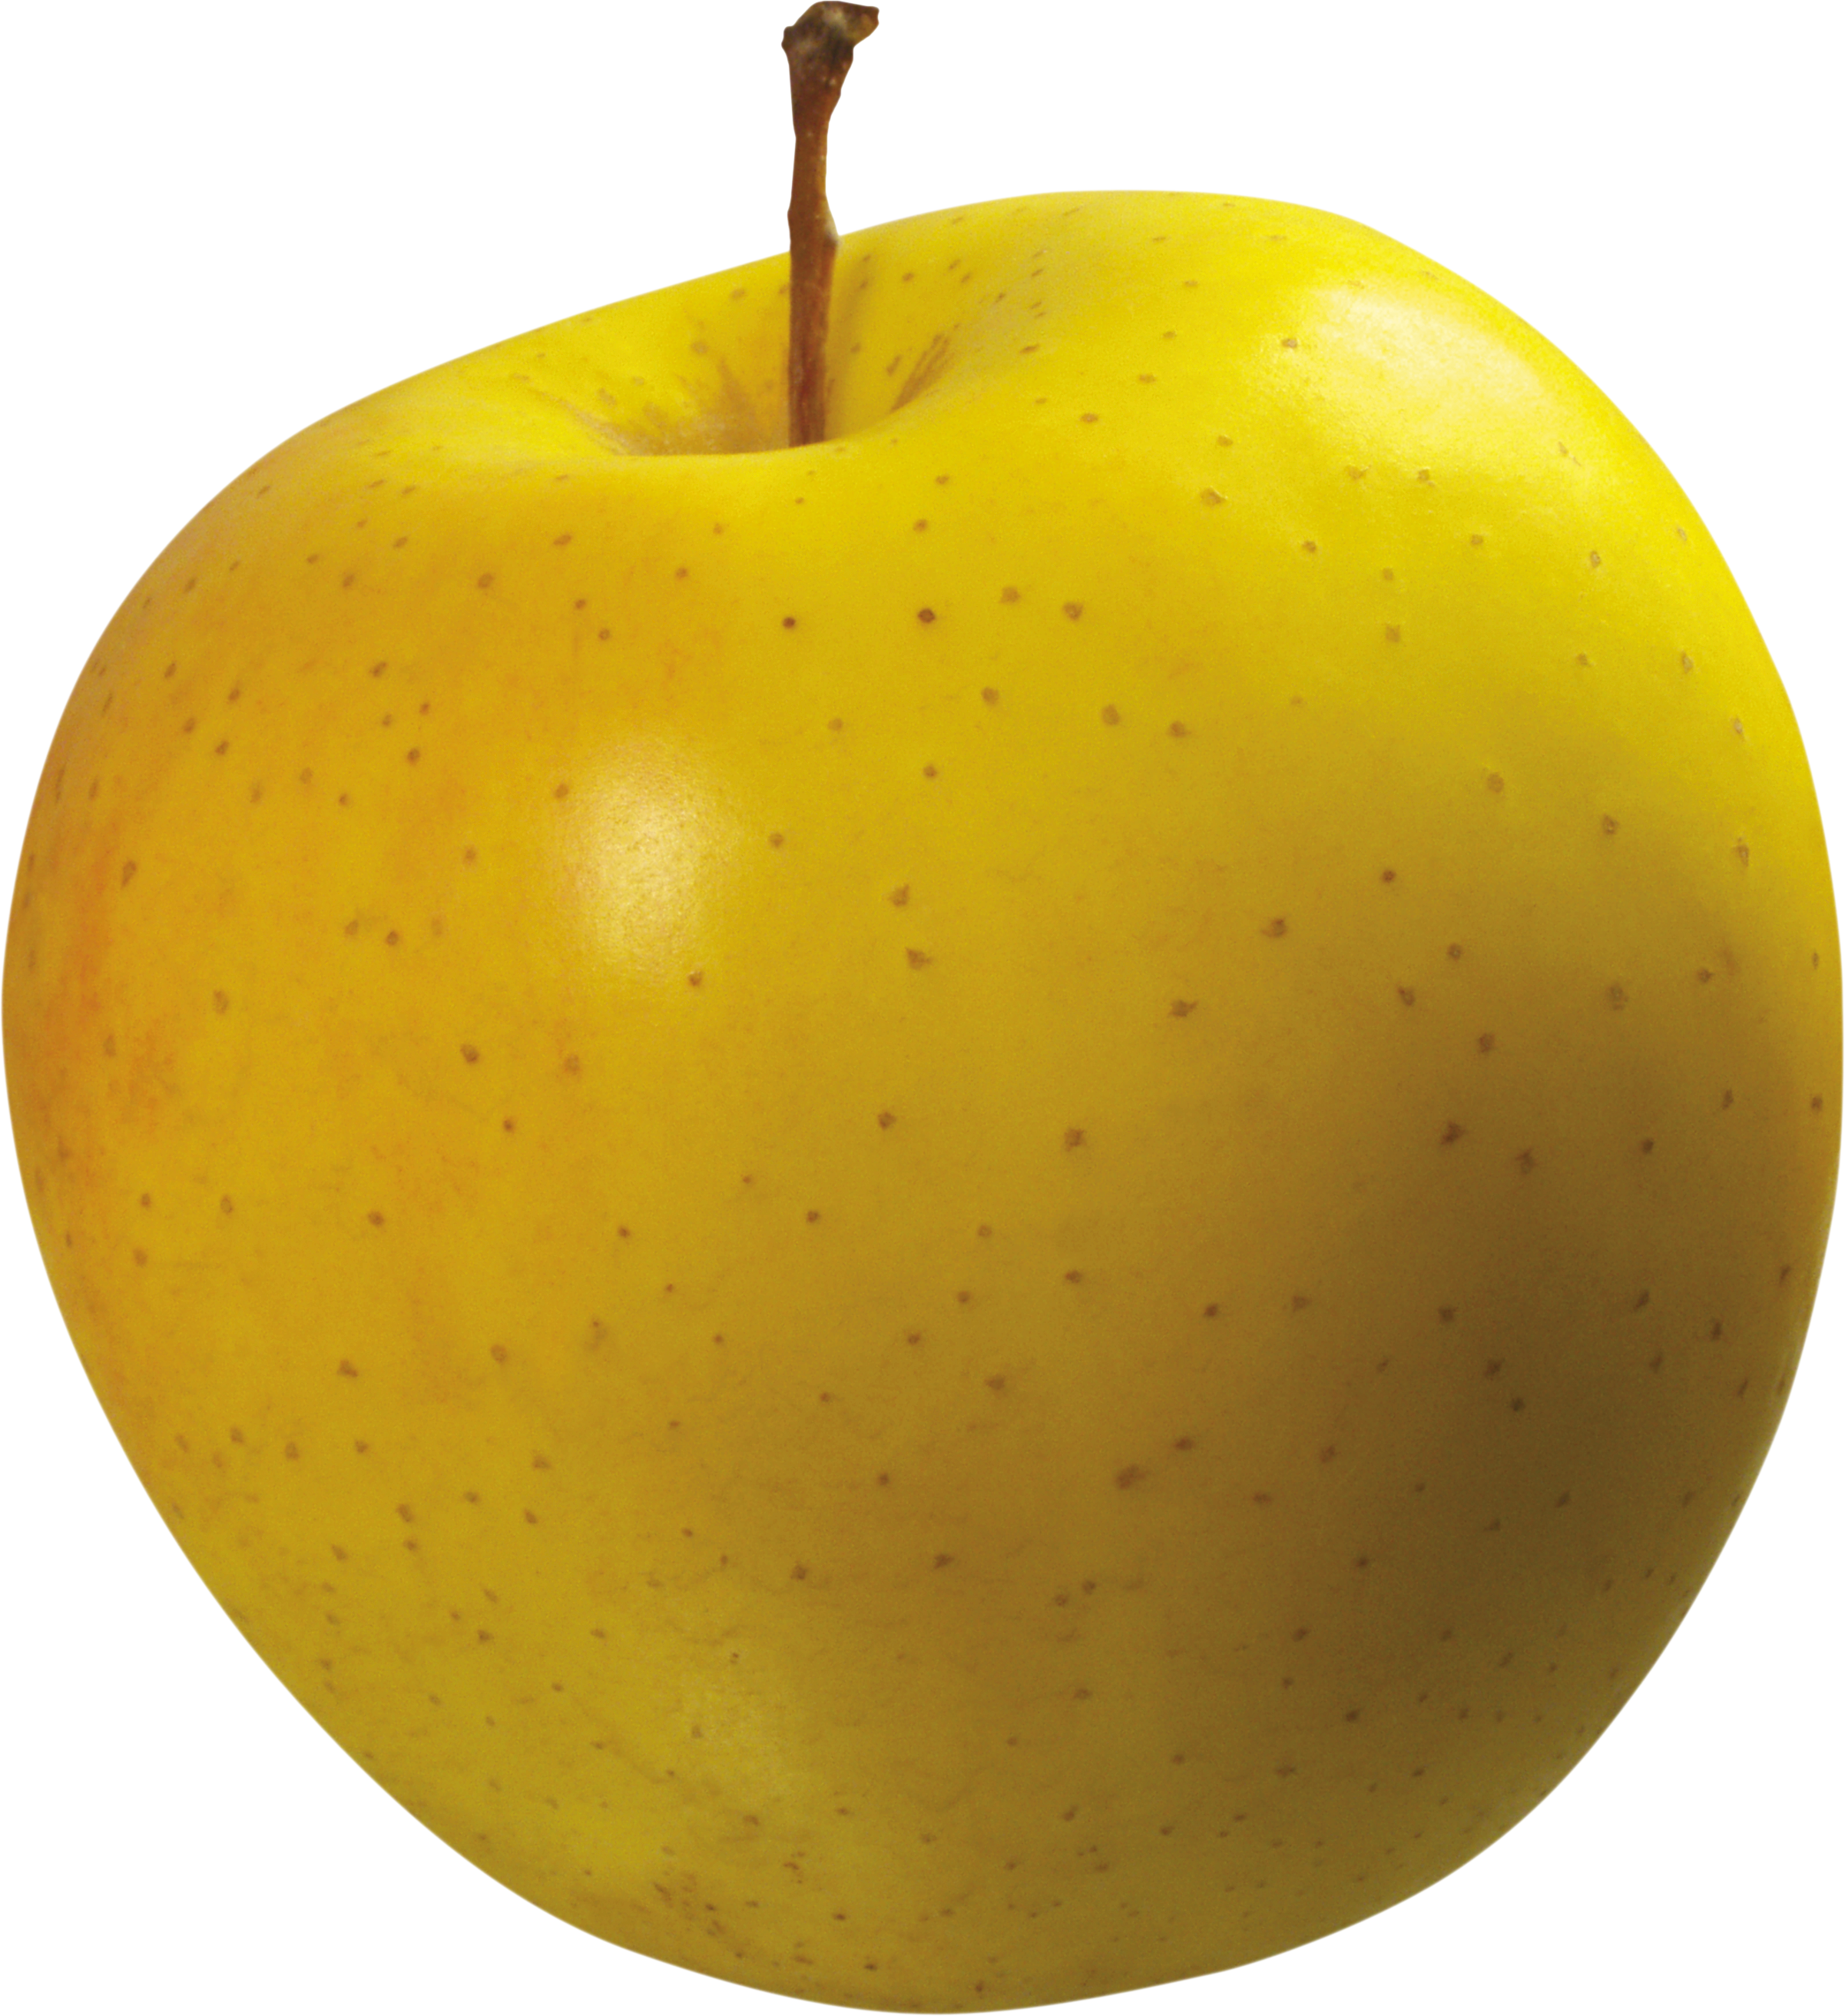
Benefits of OOP
Uses objects and classes to represent things
Allows modeling real world situations
Abstraction, inheritance, polymorphism, encapsulation
Widely used by programming

Slide 4
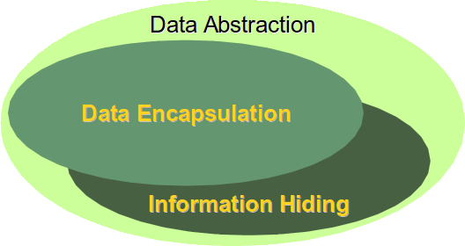
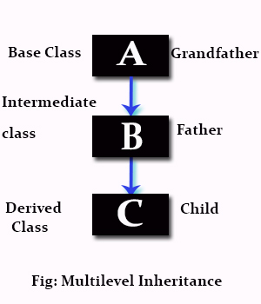
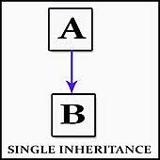
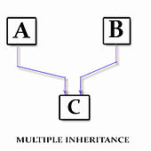
Python Object Oriented Programming Part II
Public vs Private Attributes
Inheritance

Slide 5
